Slide 1
Chapter 1
Android Operating System and Development Environment

Slide 2
Outline
Introduction
Android Architecture
Versions
Features
OHA
Dalvik VM

Slide 3
Outline
Android SDK
Android Development Tools
Android Virtual Devices
Development Environment
Directory Structure of Android Application
Android Manifest file

Slide 4
Introduction
Android is a Linux based mobile operating system.
Initially Android was available for mobile devices only.
Later on android is also available for tablets,ware, big screen(TV), automobile etc.
Android was unveiled during 2007 along with the founding of the Open Handset Alliance

Slide 5
Introduction
Android applications are usually developed in the Java language using the Android Software Development Kit.
Once developed, Android applications can be packaged easily and sold out either through a store such as Google Play, SlideME, Opera Mobile Store, Mobango, F-droid and the Amazon Appstore.
Android powers hundreds of millions of mobile devices in more than 190 countries around the world. It's the largest installed base of any mobile platform and growing fast.
Every day more than 1 million new Android devices are activated worldwide.

Slide 6
Android Architecture
Android OS is a software stack of different layers, where each layer is a group of several program components.
Android has the following layers:
Applications
Application Framework
Libraries
Android Runtime
Linux Kernel

Slide 7
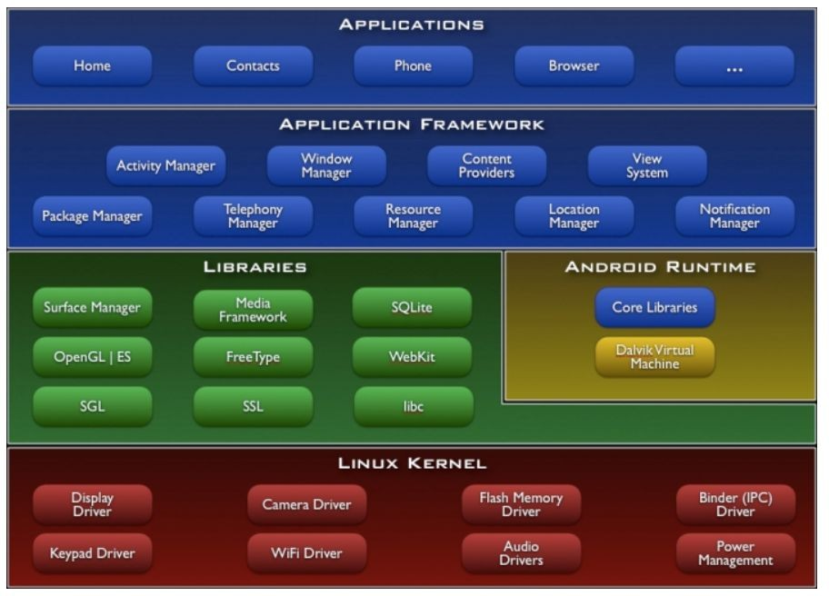
Android Architecture

Slide 8
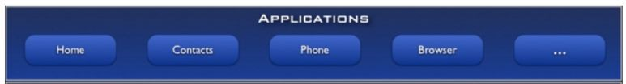
Android Architecture
Applications :
Written using Java Language
Email Client
SMS Program
Maps
Browser
Calendar
Contacts
Supports Parallel running
No compulsory applications

Slide 9
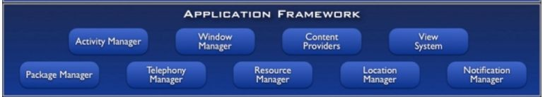
Android Architecture
Application Framework :
The Application Framework layer provides many higher-level services to applications in the form of Java classes.
Application developers are allowed to make use of these services in their applications.

Slide 10
Android Architecture
Application Framework :
The Android framework includes the following key services −
Activity Manager − Controls all aspects of the application lifecycle and activity stack.
Content Providers − Allows applications to publish and share data with other applications.
Resource Manager − Provides access to non-code embedded resources such as strings, color settings and user interface layouts.
Notifications Manager − Allows applications to display alerts and notifications to the user.
View System − An extensible set of views used to create application user interfaces.

Slide 11
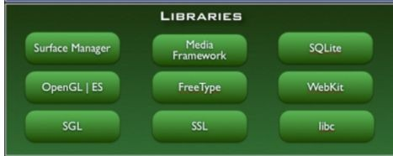
Android Architecture
Library:
Useful to develop any third-party application.
Native libraries are written in a language that compiles to native code for the platform it run.

Slide 12
Android Architecture
Library:
SQLite - Responsible for Database Operation
Free Type - Font Support
Media F/W - Audio,Video Format
Open GL(Open Google Library) - 2D,3D Graphics Support
SSL - Encrypted Communication between Client and Server
SGL (Scalable Graphics Libraries)- For Basic Graphics Support

Slide 13
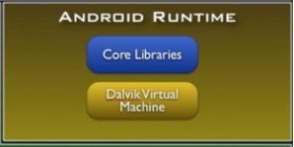
Android Architecture
Android Runtime:
Android Runtime consists of Core Libraries and Dalvik Virtual Machine.
Core Libraries are written in C/C++ languages. This libraries are helpful for runtime environment. Some of the core libraries are Data Structure, File Access, Network Access, Utilities and Graphics.

Slide 14
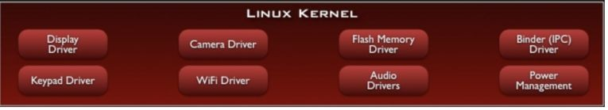
Android Architecture
Linux Kernal:
Linux Kernel is a Root layer of android Architecture which is responsible for device drivers(display, camera, Bluetooth, flash, web driver, usb, keypad,wifi etc.)
power management, memory management and resource management.

Slide 15
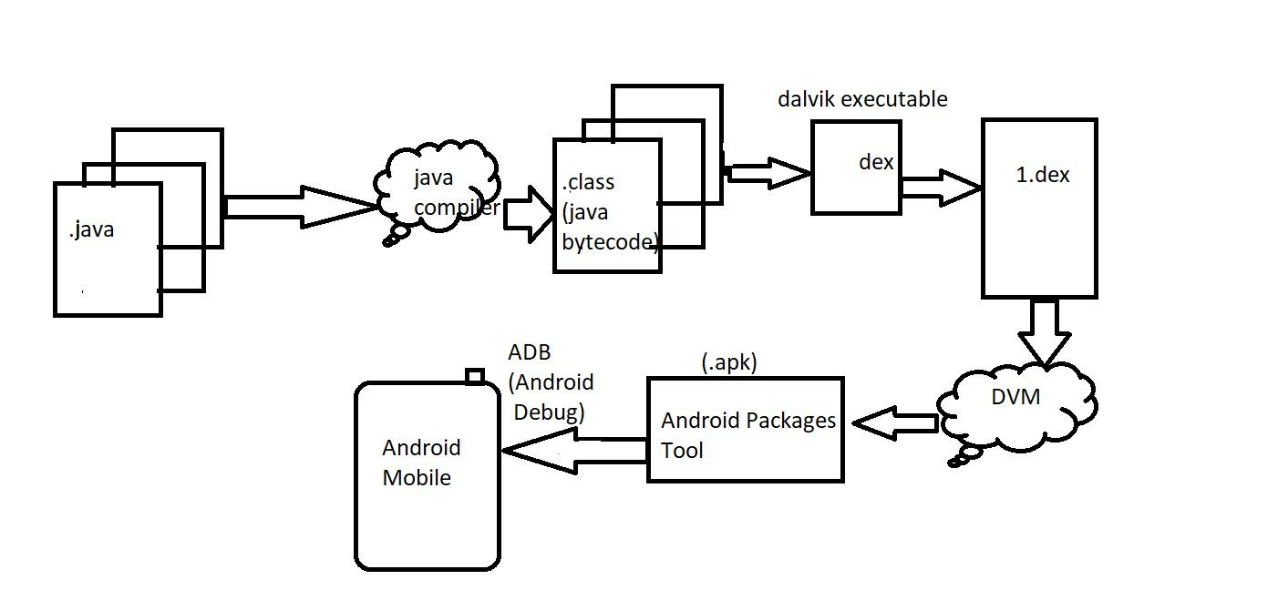
Android Architecture (How Android works)

Slide 16
Versions
Version | Nickname | Release Date
1.0 | Android | September 23,2008
1.1 | Beta Android | February 9,2009
1.5 | Cupcake | April 27,2009
1.6 | Donut | September 15,2009
Android 1.x mobiles only
Android 2.0/2.1 | Éclair | October 26,2009
2.2 – 2.2.3 | Froyo | May 20,2009
2.3 – 2.3.7 | Gingerbred | December 6,2010
Android 2.x is also designed for mobiles but from 2.x android started supporting API. - By using Google API android application can interact with Google products such as Gmail, YouTube, google maps, navigation, google search engine, google Clouds

Slide 17
Versions
Version | Nickname | Release Date
Android 3.0 – 3.2.6 | Honey Comb | February 22,2011
Android 3.x is specially designed for tablets. Started supporting Fragments
Android 4.0 – 4.0.4 | Ice-cream Sandwich | October 18,2011
4.1 – 4.3.1 | Jellybean | July 9,2012
4.4 – 4.4.4 | KitKat | October 31,2013
4.4.w supports for wearable devices like wrist-watch. From 4.x android started supporting mobiles & tablets application. It means single app can run in mobiles & tablets

Slide 18
Versions
Version | Nickname | Release Date
5.0 – 5.1.1 | Lollypop | November 12,2014
Android 5.x designed for Big Screens ie. TV
Android 6.0 – 6.0.1 | Marshmallow | October 5,2015
Android 6.0 designed for Automobiles(speed of car, km)
Android 7.0 – 7.1.2 | Nougat | August 22,2016
8.0 – 8.1 | Oreo | August 21,2017
9.0 | Pie | August 6,2018
10.0 |  | September 3,2019
11.0 |  | September 8,2020

Slide 19
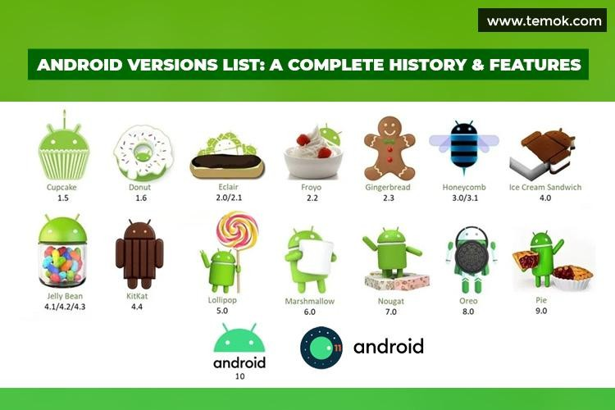
Versions

Slide 20
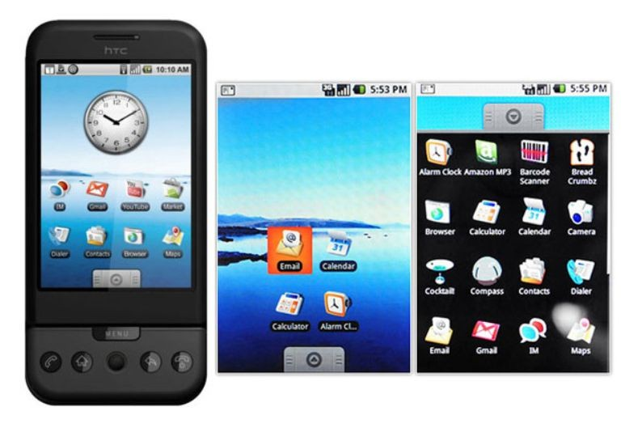
Android 1.0 to 1.1(September 23, 2008)
Features:
Google Maps.
Camera.
Gmail, Contacts, and Google Synchronization.
Web Browser.
Wireless supports – Wi-Fi and Bluetooth.

Slide 21
Beta 1.1(February 9, 2009)
released on February 9, 2009.
Features:
Add Save attachment in the message.
Provides reviews and details when the user search business on maps.

Slide 22
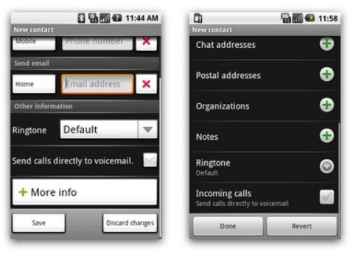
Android version 1.5: Cupcake April 30, 2009
Features:
New upload service on YouTube and Picasa like Uploading Videos and Photos.
Supporting in MPEG-4, Video recording.
Improving Web Browser-Copy and Paste facility.

Slide 23
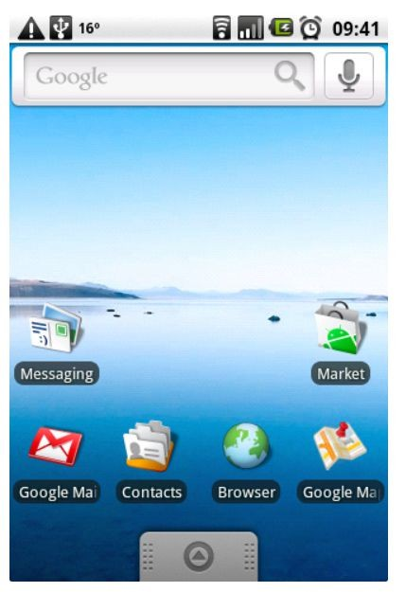
Android version 1.6: Donut September 15, 2009
Features:
The main enhancement was a Power Control widget for managing Wi-Fi, Bluetooth, GPS, etc.
Provided Gallery and Camera features with quick toggling features.
Improve the speed in system apps.
Introduction of the Quick Search Box.

Slide 24
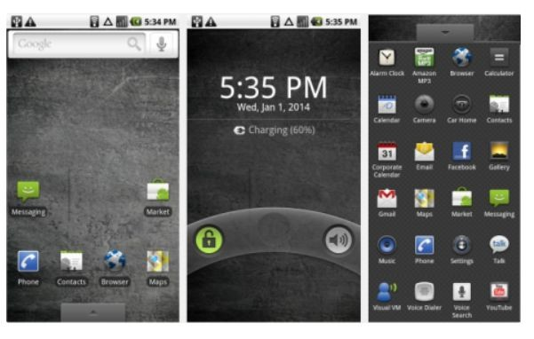
Android versions 2.0 to 2.1: Éclair December 3, 2009
Features:
Update UI.
Support Live Wallpaper.
Support Bluetooth 2.1.
Improve Google map.
Minor API Changes.

Slide 25
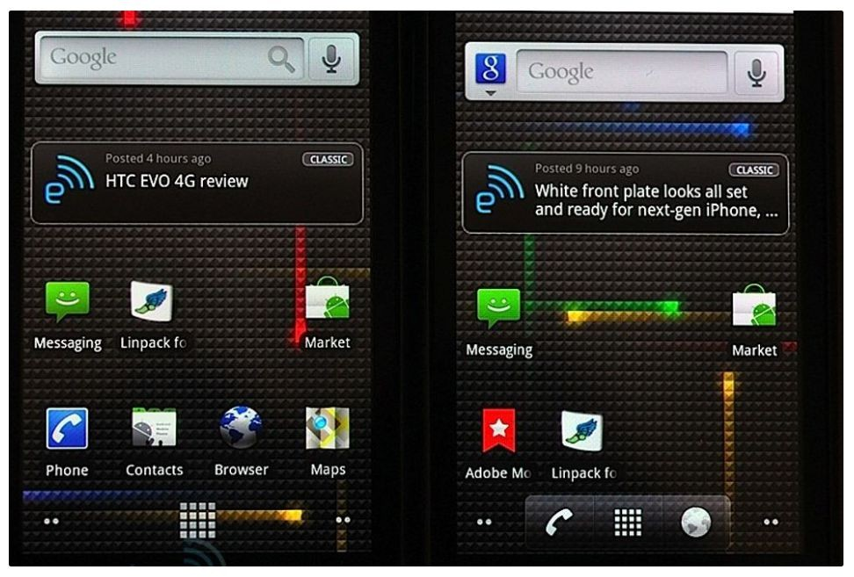
Android version 2.2: Froyo May 20, 2010
Features:
Support for Animated GIF.
Wi-Fi Support Hotspot functionality.
Speed improvements.
Upload file support in the browser.
Support numeric and alphanumeric passwords.

Slide 26
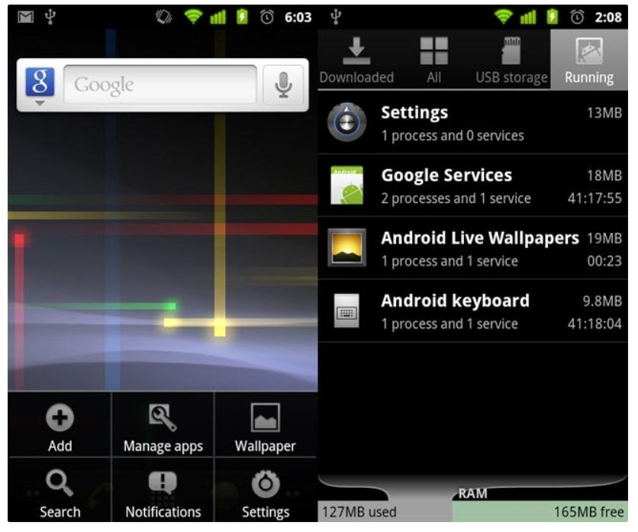
Android version 2.3: Gingerbread December 6 2010
Features:
Improve Copy-Paste Facility.
Updated UI design.
VP8 and WebM video format support.
Social Networking Supports.
Easy use of the keyboard.
Multiple camera support (usually known as a selfie camera nowadays).

Slide 27
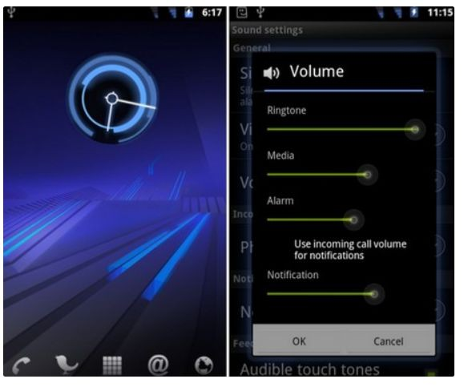
Android 3.0/3.1/3.2 – Honeycomb
Features:
Gmail App improvements.
Updated 3D UI.
Supports multiprocessors and hardware acceleration for graphics.
Media Sync from SD Card.
Google eBooks.
Google Talk Video Chat.
Support Adobe Flash in Browser.
High-performance Wi-Fi Connections and Lock.
Chinese handwriting.

Slide 28
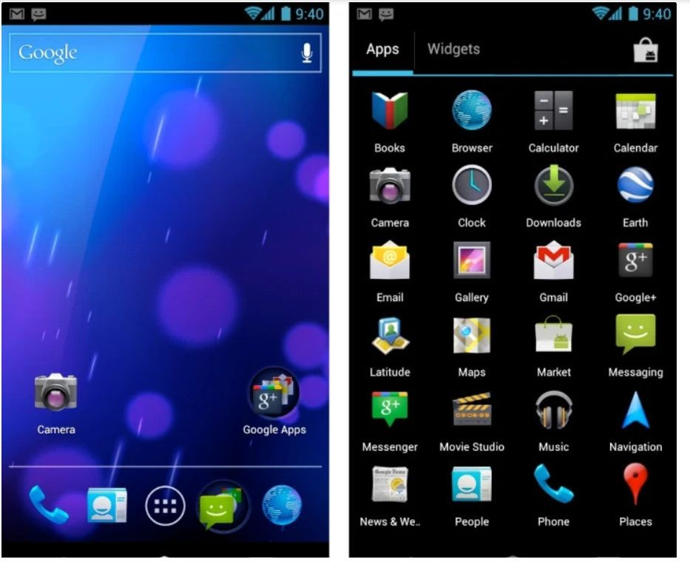
Android version 4.0: Ice Cream Sandwich October 19, 2011
Features:
Improved text input and spelling check.
Wi-Fi direct (Sharing information using NFC).
Photo Decor facility.
Improved keyboard correction.
Unlocking with face-fixing.
Improved video recording resolution.
Camera performance.
Up to 16 tabs in the web browser.

Slide 29
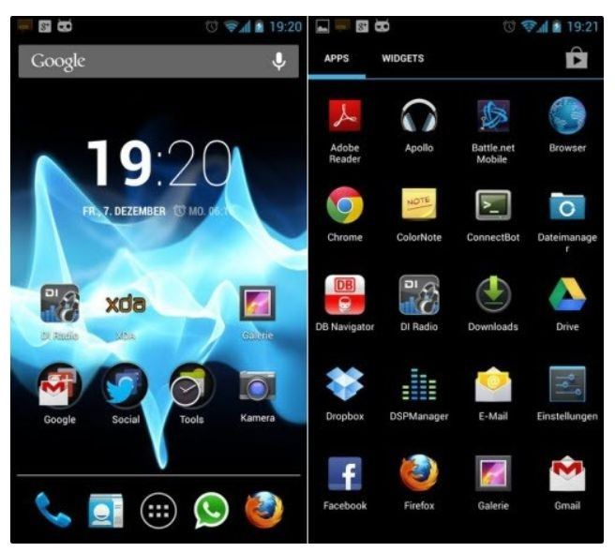
Android versions 4.1 to 4.3: Jelly Bean
Features:
Voice search.
Panorama.
Daydream as a screensaver.
Power control.
Improve camera application.
Security enhancement.
Voice typing.
Multiple user accounts on tablets only.
4k resolution support.
Supporting Bluetooth Low Energy.
Bi-directional text and other language support.
Support USB audio.
Set the volume of incoming calls and show a message alert.
Native emoji support.

Slide 30
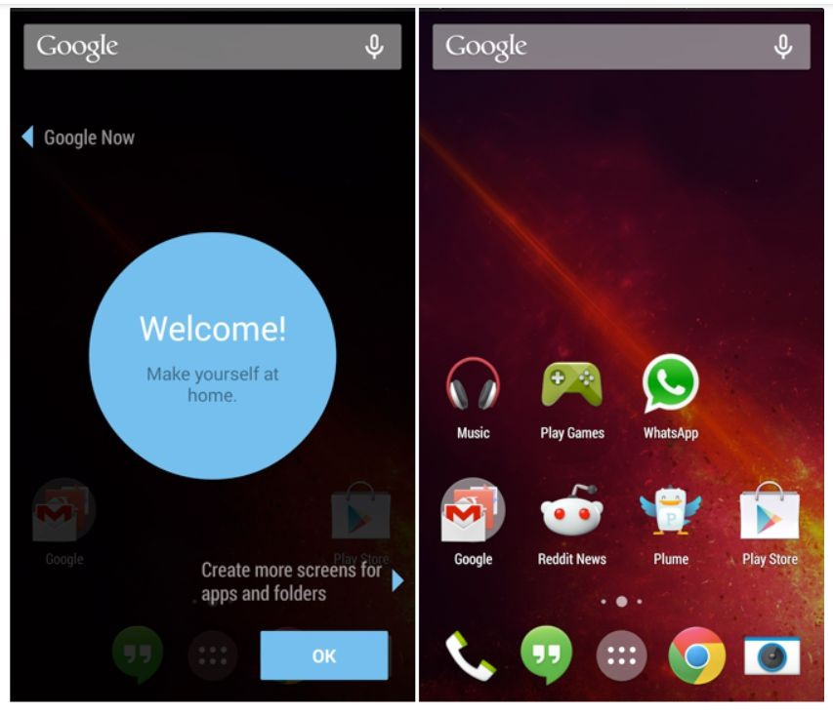
Android version 4.4: KitKat September 3, 2013.
Features:
Screen Recording.
KitKat adds a feature in ‘Google now’. Its name is ‘OK Google’. “OK, Google” allows access to Google to the users without touching your mobile phone.
GPS Support.
Offline music support.
UI updates for google map navigation and alarm.
Introduction of ‘Emoji’ to the google keyboard.

Slide 31
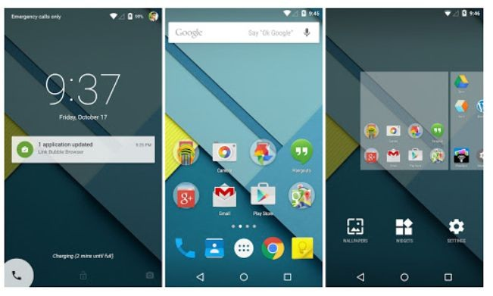
Android versions 5.0 and 5.1: Lollipop November 12, 2014
Features:
Support ART( Android Runtime).
Improvement in UI.
New material design.
Notifications on the Lock screen.
Revamped navigation bar.
Multiple sim card support.
High definition voice call.

Slide 32
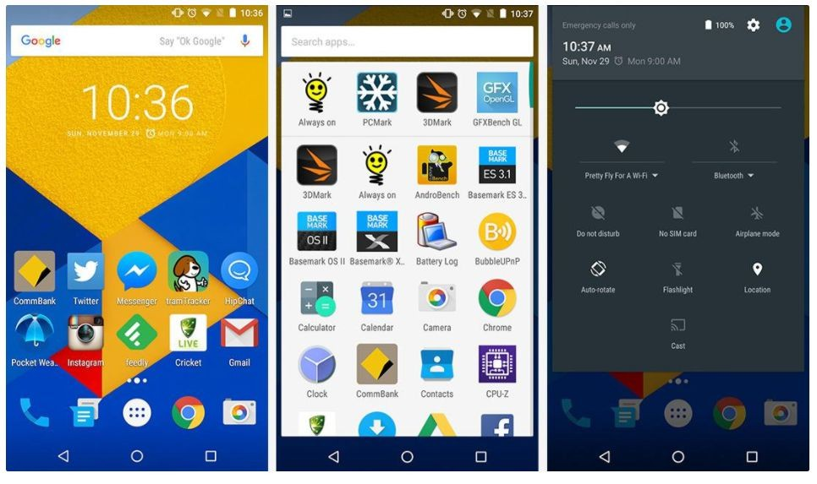
Android version 6.0: Marshmallow
Features:
Fingerprint authentication to unlock the screen.
USB Type C support.
Multi-window experiments (user can use two different apps in one screen).
Save battery-’Sleep Mode’.
App permission
model-OPT(send a request for permission).

Slide 33
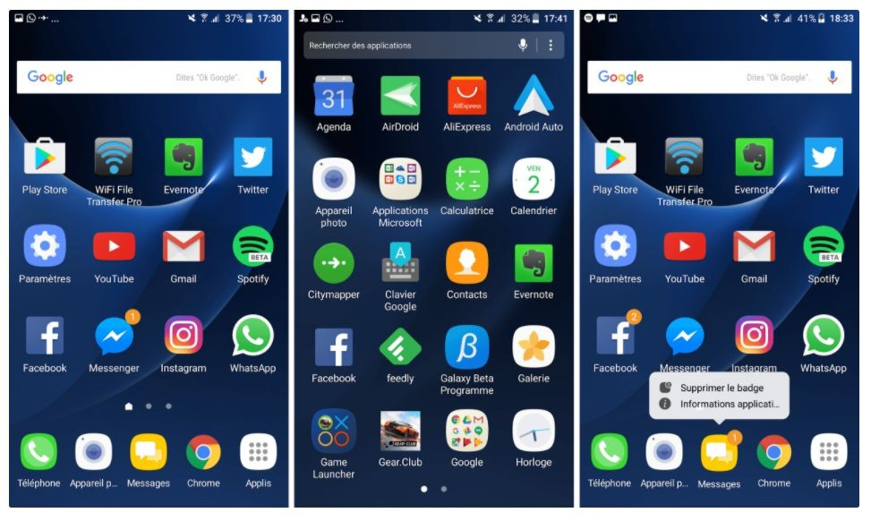
Android versions 7.0 and 7.1: Nougat March 2016
Features:
Provide multitasking.
Inline reply to messages and notifications so you won’t have to open up your Messenger application for quick replies.
Providing multi-window mode.
Improvements in storage manager.
Display touch improvement.

Slide 34
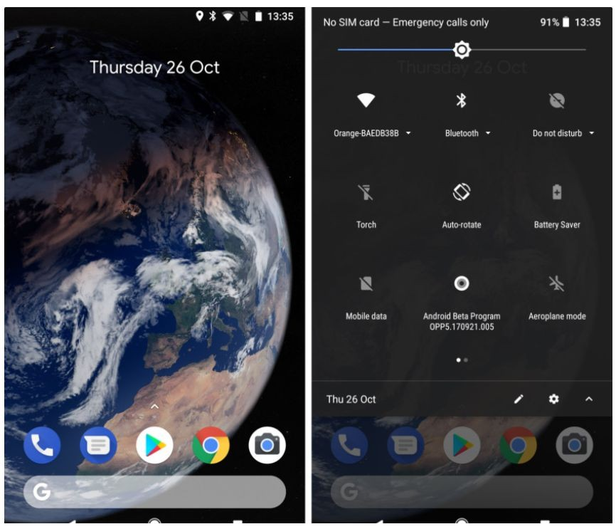
Android version 8.0 and 8.1: Oreo
Features:
Support PIP(Picture-in-Picture).
Multi-display support.
Google Play support.
Adaptive icons.
Revamped notification section(Users can set which notifications you want to show).

Slide 35
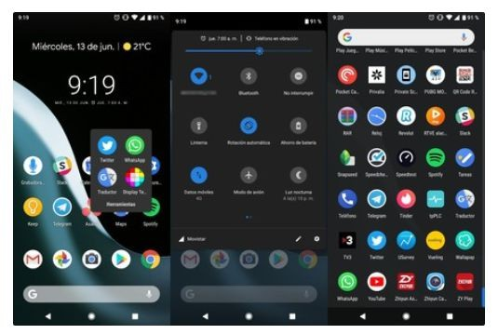
Android version 9: Pie August 2018.
Features:
New Gesture Navigation.
Artificial intelligence (AI) Compatible.
Adaptive Battery and Brightness.
App Actions.
New Screenshot Shortcuts.
Easier Screen Rotation.
Volume and Sound Improvement.
Selectable Dark Mode.
Slices.
Improved Security Features.
Digital Wellbeing.
New Accessibility Menu.
Easier Text Selection.
More Notification Information.

Slide 36
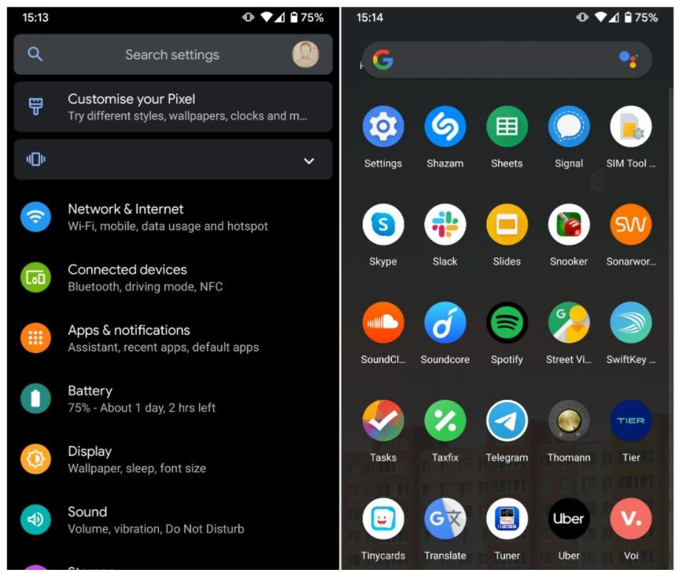
Android version 10: Android Q September 3, 2019
Features:
Support for the upcoming foldable smartphones with flexible displays which is an upcoming rush.
System-wide dark mode.
Navigation control over gesture.
Smart reply for all messaging apps.
Support for Live caption.
Better notification control.

Slide 37
Android version 11 (Developer Preview) preview on February 19 of year 2021.
Features (announced):
New Support for 5G.
Privacy and Security; A new privacy choice for apps is the “Only This Time” option when you’re allowing the app access to your location, microphone, or camera.
Support new screen types (pinhole and waterfall).
Low Latency Options; adds low latency support in new MediaCodec APIs and HDMI which is very useful for use on external displays and TVs.

Slide 38
Features
1. Open Source: the original source code of android is available for modifications.
2. Android OS is device independent.
3. Android OS supports NFC(Near Field Communication)– Transfer any amount of data by simply touching the two devices.– Maintain less than 1 cm distance in between two devices.
4. Android OS supports IPC(Inter Process Communication)
5. By default Android OS is available with SQLite

Slide 39
Features
6. Android OS supports for SSL(Secure Socket Layer)– TLS(Transport Layer Security)– In SSL client & server interaction done in encrypted mode.
7. Android OS will support Text to Speech and Speech to Text conversion.
8. Android device can be controlled through voice commands.
9. Android supports all types of images, audio, video,different types of languages, different types of fonts.
10. Android OS supports basic graphics and 2-D,3-D animation.

Slide 40
Features
11. Supports Video calling.
12. External storage– Most Android devices include microSD slot and can read microSD cards formatted with FAT32,Ext3 or Ext4 file system

Slide 41
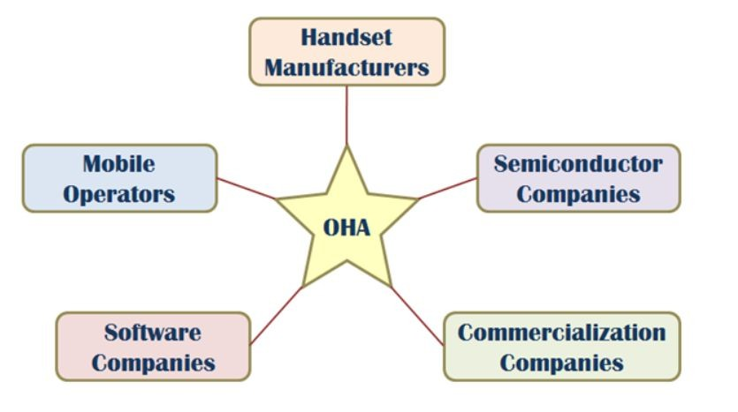
OHA
Open Handset Alliance(OHA) was formed in November 2007.
The OHA is the group that is in charge of the Android Smartphone Operating System. It was created by Google.
The OHA is a business alliance that consists of 47 companies for developing open standard platform for mobile devices.
The members of OHA includes handset manufactures, chip makers, commercialization companies, software companies and mobile operators.

Slide 42
Dalvik VM
Runtime environment for running android application.
JVM is used to run high-end applications while DVM is used for small-end applications.
DVM was first written by "Dan Bornstein“
Unlike JVM, the DVM does not run .class files but it runs .dex files.
.dex files are built from .class file at the time of compilation and provide higher efficiency in row resource environments.

Slide 43
Android SDK
Android SDK is a software development kit developed by Google for the Android platform.
Android SDK comes bundled with Android Studio, Google's official integrated development environment (IDE) for the Android operating system

Slide 44
Android SDK
The Android SDK is a collection of software development tools and libraries required to develop Android applications.
Every time Google releases a new version of Android or an update, a corresponding SDK is also released which developers must download and install.
The Android SDK comprises all the tools necessary to code programs from scratch and even test them. These tools provide a smooth flow of the development process from developing and debugging, through to packaging.
The Android SDK is compatible with Windows, macOS, and Linux, so you can develop on any of those platforms.

Slide 45
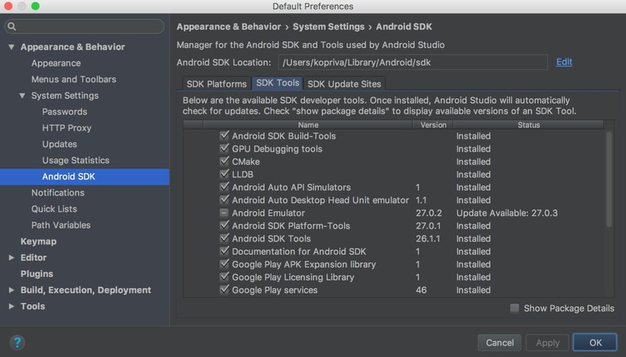
Android SDK

Slide 46
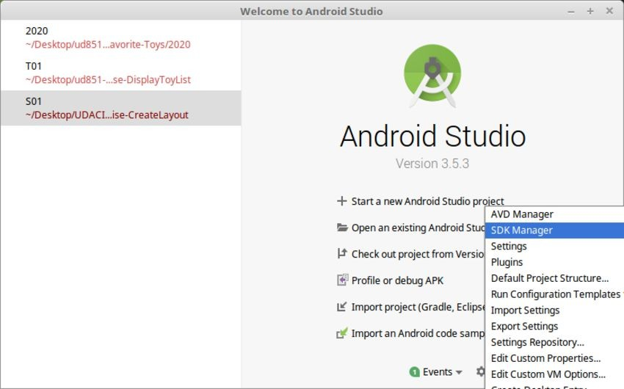
Android SDK
To install the Android SDK from within Android Studio, first start Android Studio.
From the Android Studio start page, select Configure > SDK Manager.

Slide 47
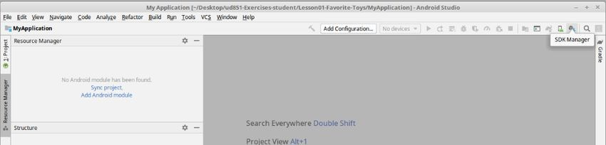
Android SDK
If you already have Android Studio open, the SDK Manager icon is found on the top right corner, as shown below.

Slide 48
Android SDK
The Android SDK consists of an emulator, development tools, sample projects with source code, Google API, and the required libraries to build Android applications

Slide 49
Android SDK
Provided in the android.jar file that made up of several important packages.
Top-Level Package Name | Description
android.* | Android application fundamentals
dalvik.* | Dalvik Virtual machine support fundamentals
java.* | Core java classes and generic utilities for networking, security, math and so on
javax.* | Encryption support
junit.* | Unit-Testing support
org.apache.http.* | HTTP Protocol support
org.json | JavaScript Object Notation Support

Slide 50
Android SDK
Few Popular Third-Party Android APIs:
Com.google.android.gms.ads.* = Google Mobile Ads SDK Package.
Com.google.android.gms.analytics.* = Google Analytics SDK for Android Package.
Com.google.android.gms.gcm = Google Cloud Messaging for Android.
Com.google.android.gms.appindexing = Google App Indexing Package.
Com.google.android.gms.appinvite = Google App Invites Package
Com.google.android.gms.games = Google Play Games Services Package
Com.google.android.gms.fitness = Google Fit Package

Slide 51
Android SDK
Android SDK provides many tools to design, develop, debug and deploy your applications.
Android Studio
Android SDK and AVD Managers
Android Emulator

Slide 52
Android Virtual Devices
An Android Virtual Device (AVD) is a configuration that defines the characteristics of an Android device you want to simulate in the Android Emulator. This includes the device's hardware profile, system image, storage area, skin, and other properties

Slide 53
Android Virtual Devices
Key Components of AVD
Hardware Profile: Defines the characteristics of a device as shipped from the factory. The Device Manager in Android Studio comes pre-loaded with certain hardware profiles, such as Pixel devices, and you can define or customize the hardware profiles as needed¹.
System Image: A system image labeled with Google APIs includes access to Google Play services. The API level of the target device is crucial because your app doesn't run on a system image with an API level lower than the one required by your app¹.
Storage Area: The AVD has a dedicated storage area on your development machine. It stores the device user data, such as installed apps and settings, as well as an emulated SD card¹.
Skin: An emulator skin specifies the appearance of a device. The Device Manager provides some predefined skins, and you can also define your own or use skins provided by third parties

Slide 54
Android Virtual Devices
Creating and Managing AVDs
To create a new AVD, you can use the Device Manager in Android Studio. Here are the steps:
Open the Device Manager.
Click "Create Device."
Select a hardware profile and click "Next."
Select the system image for a particular API level and click "Next."
Change the AVD properties as needed and click "Finish"

Slide 55
Android Virtual Devices
Advantages of Using AVD
Testing and Debugging: The Android emulator provides almost all the functionality of a real device, making it easier to test and debug applications without needing physical hardware.
Predefined Configurations: The emulator comes with predefined configurations for several Android phones, Wear OS, tablet, and Android TV devices.
Faster Data Transfer: Transferring data to the emulator is faster than to a real device connected through USB.

Slide 56
Android Virtual Devices
Limitations of AVD
Performance: Emulators can be slower compared to actual physical devices.
Accuracy: Testing on an emulator is not as accurate as using a real device, especially for network and hardware-related activities.
In summary, an AVD is a powerful tool for Android developers, allowing them to simulate various Android devices and test their applications in a controlled environment

Slide 57
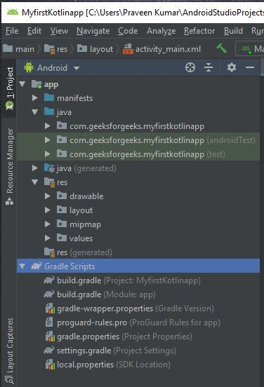
Directory Structure of Android Application
Android Studio is the official IDE (Integrated Development Environment) developed by the JetBrains community which is freely provided by Google for android app development. After completing the setup of Android Architecture we can create an android application in the studio. We need to create a new project for each sample application and we should understand the folder structure. It looks like this:

Slide 58
Directory Structure of Android Application
The android project contains different types of app modules, source code files, and resource files. We will explore all the folders and files in the android app.
Manifests Folder
Java Folder
res (Resources) Folder
Drawable Folder
Layout Folder
Mipmap Folder
Values Folder
Gradle Scripts

Slide 59
Directory Structure of Android Application
Manifests Folder
Manifests folder contains AndroidManifest.xml for creating our android application. This file contains information about our application such as the Android version, metadata, states package for Kotlin file, and other application components. It acts as an intermediator between android OS and our application.

Slide 60
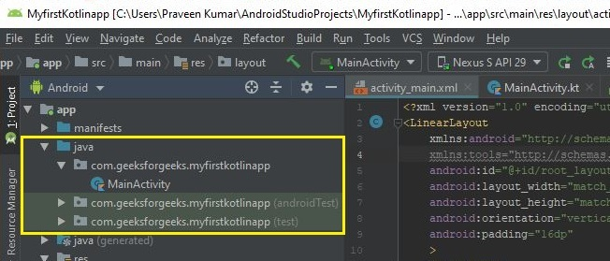
Directory Structure of Android Application
Java folder
The Java folder contains all the java and Kotlin source code (.java) files that we create during the app development, including other Test files. If we create any new project using Kotlin, by default the class file MainActivity.kt file will create automatically under the package name “com.geeksforgeeks.myfirstkotlinapp” as shown below.

Slide 61
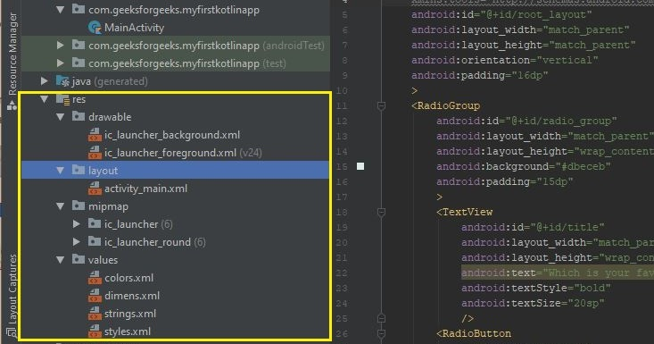
Directory Structure of Android Application
Resource (res) folder
The resource folder is the most important folder because it contains all the non-code sources like images, XML layouts, and UI strings for our android application.

Slide 62
Directory Structure of Android Application
res/drawable folder It contains the different types of images used for the development of the application. We need to add all the images in a drawable folder for the application development.
res/layout folder The layout folder contains all XML layout files which we used to define the user interface of our application.

Slide 63
Directory Structure of Android Application
res/mipmap folder\
This folder contains launcher.xml files to define icons that are used to show on the home screen. It contains different density types of icons depending upon the size of the device such as hdpi, mdpi, xhdpi.
res/values folder Values folder contains a number of XML files like strings, dimensions, colors, and style definitions.

Slide 64
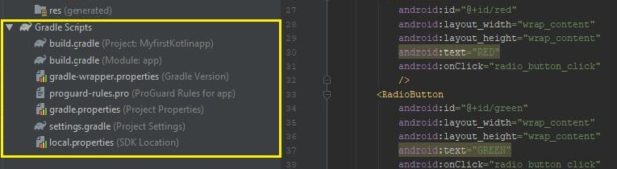
Directory Structure of Android Application
Gradle Scripts folder
Gradle means automated build system and it contains a number of files that are used to define a build configuration that can be applied to all modules in our application. In build.gradle (Project) there are buildscripts and in build.gradle (Module) plugins and implementations are used to build configurations that can be applied to all our application modules.

Slide 65
Android Manifest file
Every project in Android includes a Manifest XML file, which is AndroidManifest.xml, located in the root directory of its project hierarchy. The manifest file is an important part of our app because it defines the structure and metadata of our application, its components, and its requirements.
This file includes nodes for each of the Activities, Services, Content Providers, and Broadcast Receivers that make the application, and using Intent Filters and Permissions determines how they coordinate with each other and other applications.

Slide 66
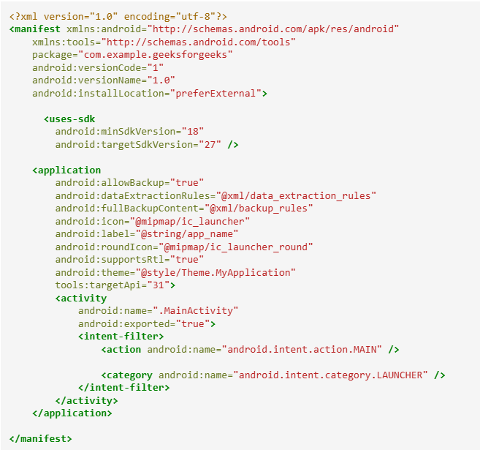
Android Manifest file

Slide 67
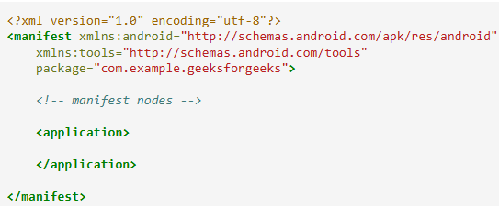
Android Manifest file
1. manifest
The main component of the AndroidManifest.xml file is known as manifest. Additionally, the packaging field describes the activity class’s package name. It must contain an <application> element with the xmlns:android and package attribute specified.

Slide 68

Android Manifest file
2. uses-sdk
It is used to define a minimum and maximum SDK version by means of an API Level integer that must be available on a device so that our application functions properly, and the target SDK for which it has been designed using a combination of minSdkVersion, maxSdkVersion, and targetSdkVersion attributes, respectively. It is contained within the <manifest> element.

Slide 69

Android Manifest file
3. uses-permission
It outlines a system permission that must be granted by the user for the app to function properly and is contained within the <manifest> element. When an application is installed (on Android 5.1 and lower devices or Android 6.0 and higher), the user must grant the application permissions.

Slide 70
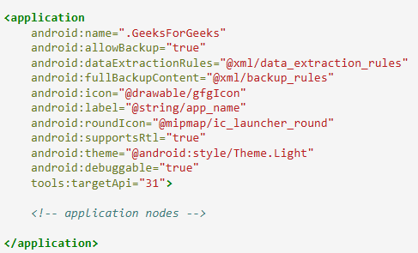
Android Manifest file
4. application
A manifest can contain only one application node. It uses attributes to specify the metadata for your application (including its title, icon, and theme). During development, we should include a debuggable attribute set to true to enable debugging, then be sure to disable it for your release builds. The application node also acts as a container for the Activity, Service, Content Provider, and Broadcast Receiver nodes that specify the application components. The name of our custom application class can be specified using the android:name attribute.

Slide 71

Android Manifest file
5. uses-library
It defines a shared library against which the application must be linked. This element instructs the system to add the library’s code to the package’s class loader. It is contained within the <application> element.

Slide 72

Android Manifest file
6. activity
The Activity sub-element of an application refers to an activity that needs to be specified in the AndroidManifest.xml file. It has various characteristics, like label, name, theme, launchMode, and others. In the manifest file, all elements must be represented by <activity>. Any activity that is not declared there won’t run and won’t be visible to the system. It is contained within the <application> element.

Slide 73

Android Manifest file
7. intent-filter
It is the sub-element of activity that specifies the type of intent to which the activity, service, or broadcast receiver can send a response. It allows the component to receive intents of a certain type while filtering out those that are not useful for the component. The intent filter must contain at least one <action> element.

Slide 74
Android Manifest file
8. action
It adds an action for the intent-filter. It is contained within the <intent-filter> element.
9. category
It adds a category name to an intent-filter. It is contained within the <intent-filter> element.

Slide 75
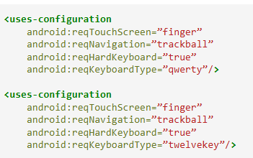
Android Manifest file
10. uses-configuration
The uses-configuration components are used to specify the combination of input mechanisms that are supported by our application. It is useful for games that require particular input controls.

Slide 76
Android Manifest file
11. uses-features
It is used to specify which hardware features your application requires. This will prevent our application from being installed on a device that does not include a required piece of hardware such as NFC hardware, as follows:

Slide 77
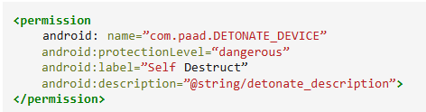
Android Manifest file
12. permission
It is used to create permissions to restrict access to shared application components. We can also use the existing platform permissions for this purpose or define your own permissions in the manifest.

